Slide 1
STOCK MARKET TREND PREDICTION WITH TECHNICAL INDICATORS
Name: Namith Ravindranath
Student ID: 23040851

Slide 2
Project Overview
Objective: Predict next-day direction (Up/Down) of TSLA stock
Data Source: 10 years of TSLA data (2014–2024) from Yahoo Finance.
Models Used: Random Forest, XGBoost, LSTM
Tools: yFinance, Python, SMOTE, Anaconda

Slide 3
Research Aim & Questions
Aim: Build a prediction model using technical indicators
Research Question : How accurately can stock price direction be predicted using ML algorithms with indicators like MACD, RSI, Volume, etc.?

Slide 4
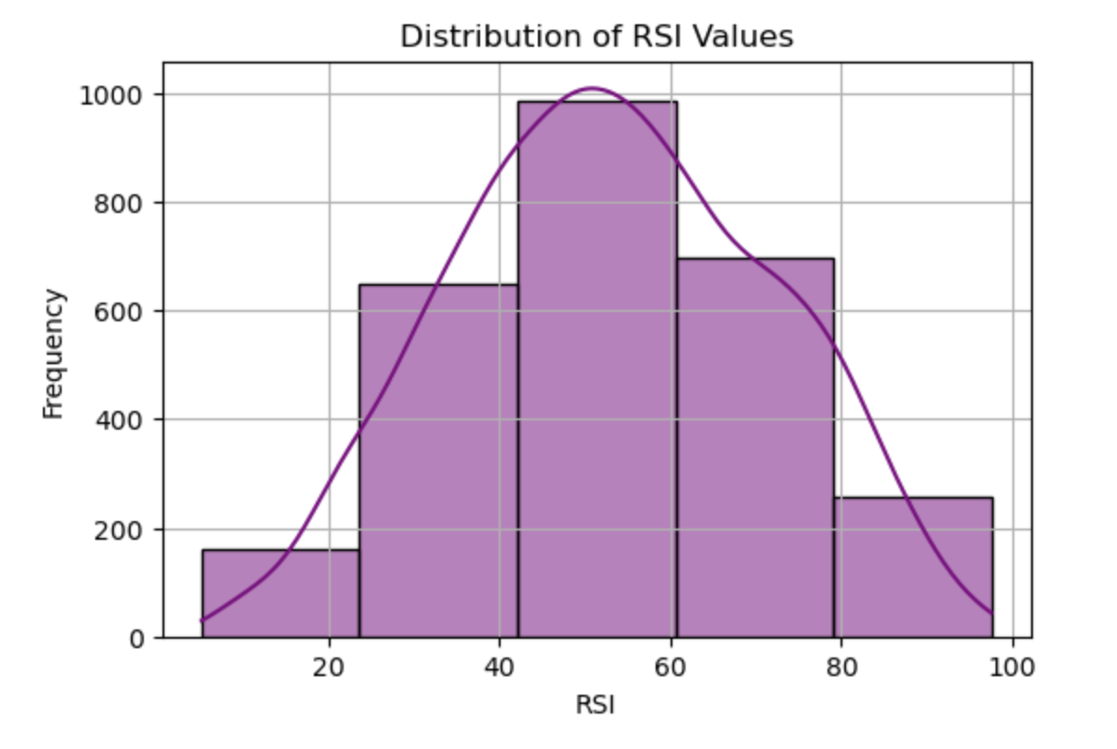
Technical Indicators Used
MACD (Moving avg Convergence Divergence): Momentum indicator that helps identify buy/sell signals.
RSI (Relative Strength Index): Identifies overbought/oversold conditions.
Bollinger Bands: Show volatility using standard deviations.
Volume: Show price strength and market activity.

Slide 5
Methodology
Data Acquisition: yFinance (2014–2024)
Preprocessing: Filling null values by simple imputer
Feature Engineering: Calculating technical indicators
Target Variable: Binary classification (1: Up, 0: Down)

Slide 6
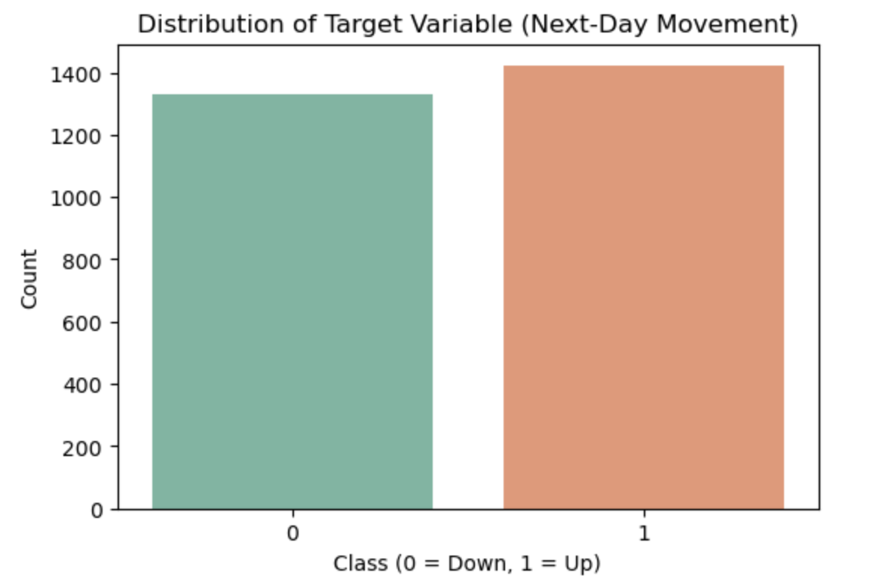
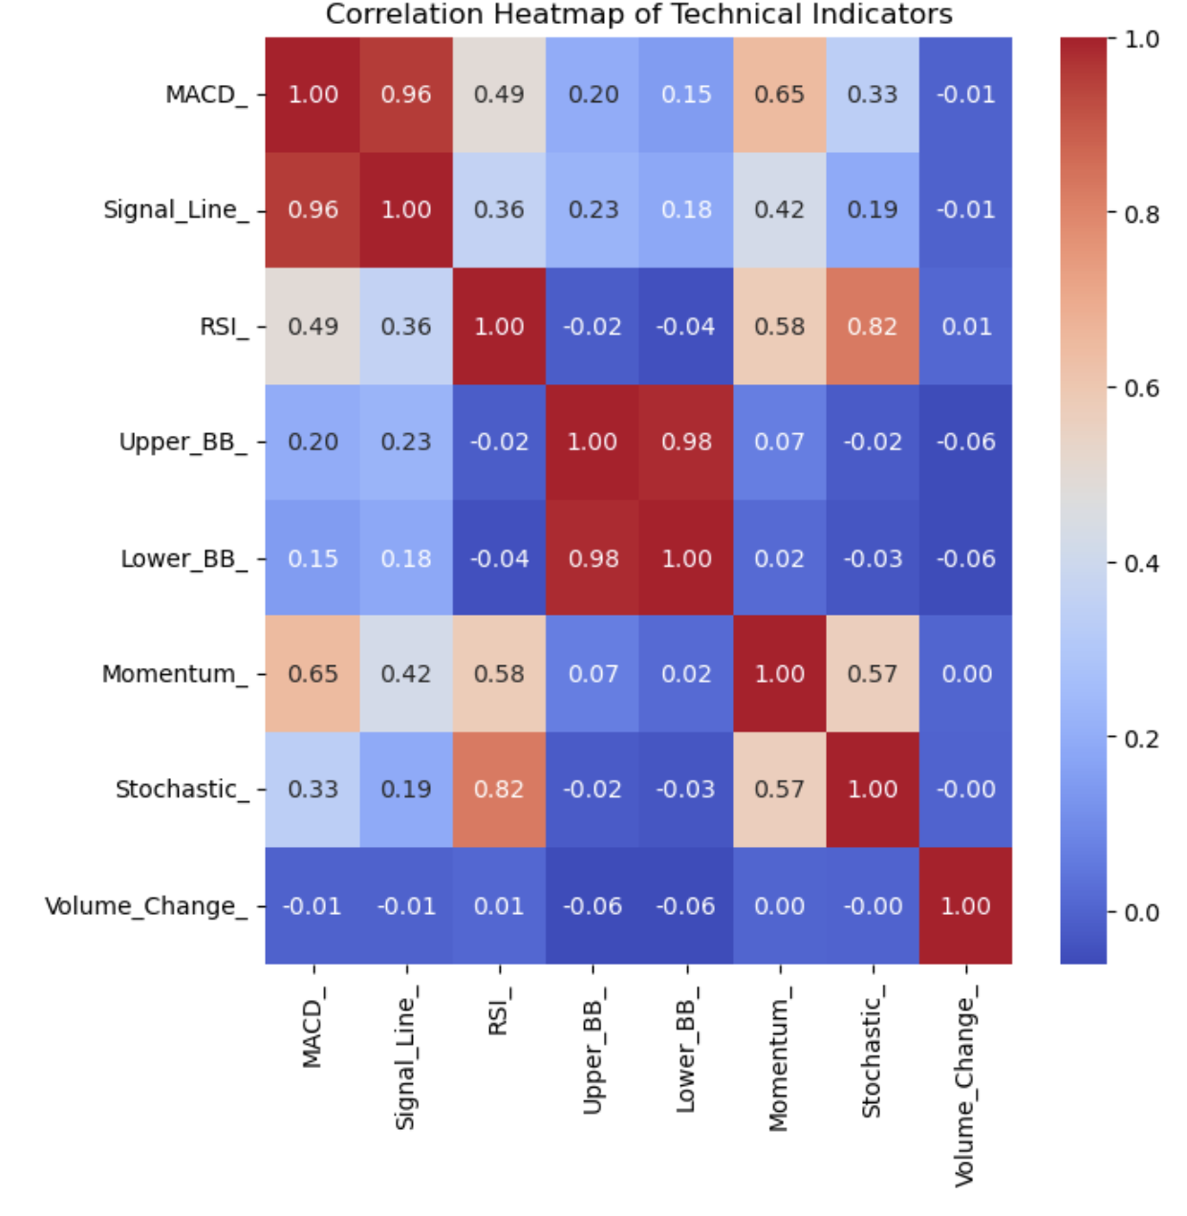
Exploratory Data Analysis
The long-term trends, volatility, and seasonal effects were visualized by creating the time series plots of Tesla's closing price over the past ten years.
The distribution of the values of RSI was determined using histogram plots, especially the RSI values.
The technical indicators were prepared in a correlation heatmap to analyse multi-collinearity as well as to comprehend the interplay of one feature with other features.

Slide 7
Model Implementation
Random Forest: Tree-based ensemble
XGBoost: Gradient boosting with regularization
LSTM: Captures temporal patterns in time series
Data Split: 80% train, 20% test (chronological)
Resampling: SMOTE to address class imbalance

Slide 8
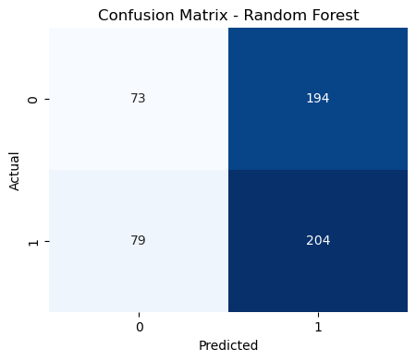
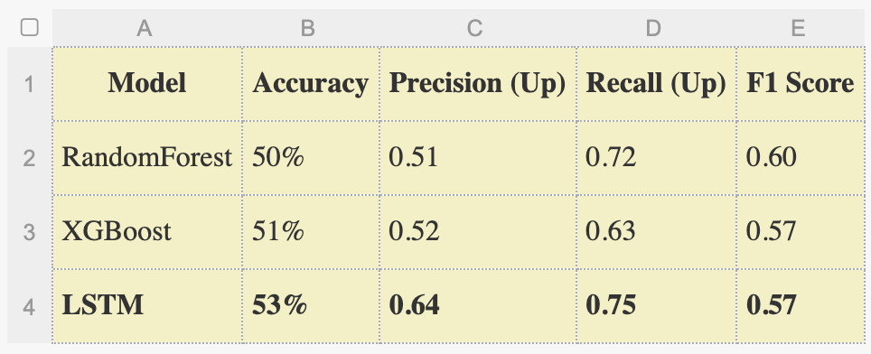
Model Results
As can be seen from the results of this study, all three models, Random Forest, XGBoost, and LSTM, yielded approximately to 50%, 51% & 53%, but the internal performance indicators differed considerably.
Each of the models had a superior result in the upward trends (class 1) compared to the number of downward movements (class 0), with LSTM being the best model in terms of predicting stock rises (recall 0.75).
This demonstrates the effectiveness of the LSTM in modelling the temporal pattern, though with the overall accuracy being improved.

Slide 9
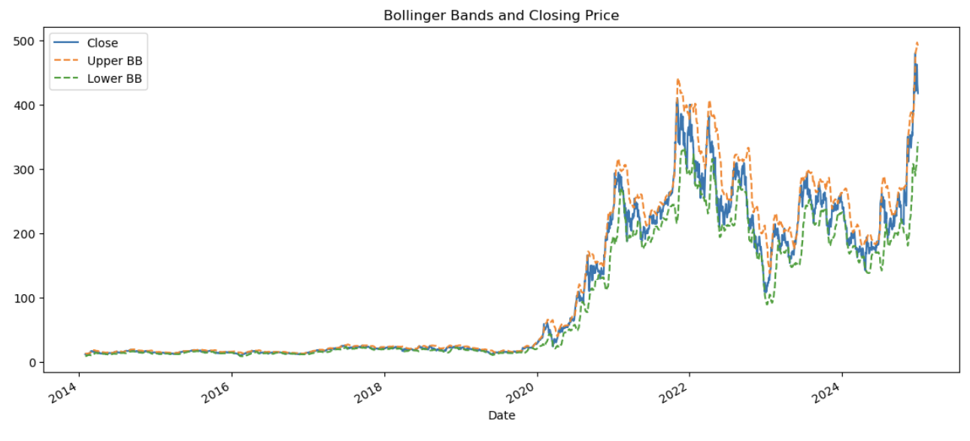
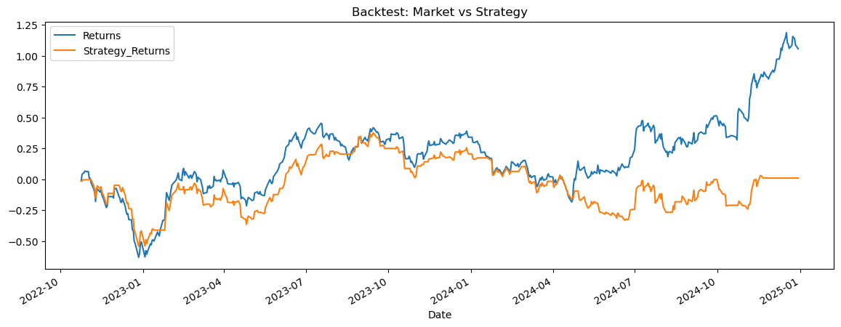
Backtesting Strategy
Used predicted values to simulate trading
Plotted cumulative returns vs market returns
Found model performance lagging in high-volatility periods
Bollinger Band chart used for volatility visualization

Slide 10
Discussion & Limitations
LSTM best at model temporal data
Models were successful in directional prediction
Accuracy remains near random guessing
Limitations:
No sentiment/macroeconomic data
Binary classification oversimplifies complex market behavior

Slide 11
References
Fidelity (2024). What is RSI? - Relative Strength Index - Fidelity. [online] Fidelity.com. Available at: https://www.fidelity.com/learning-center/trading-investing/technical-analysis/technical-indicator-guide/RSI.
Gao, Y., Wang, R. and Zhou, E., 2021. Stock prediction based on optimized LSTM and GRU models. Scientific Programming, 2021(1), p.4055281.
Hakkal, S. and Lahcen, A.A. (2024). XGBoost To Enhance Learner Performance Prediction. Computers and Education: Artificial Intelligence, 7, p.100254.
Li, X. and Wu, P., 2022. Stock price prediction incorporating market style clustering. Cognitive Computation, 14(1), pp.149-166.
Olorunnimbe, K. and Viktor, H. (2022). Deep learning in the stock market—a systematic survey of practice, backtesting, and applications. Artificial Intelligence Review.

Slide 12
THANK YOU

